Slide 1
C300 Final Evaluation
Project ID:
SOI-2025-2510-0005
Project Title:
Customer Shopping Trend and Behaviour Analysis
Team ID:
SOI-2025-0010
Team Members:
1. Han Shen
2. Eva
3. Muhsinah

Slide 2
Introduction
Analyze customer purchasing patterns to uncover trends and behaviors using a comprehensive retail dataset.
Focus Areas: Data preprocessing and cleaning, Exploratory Data Analysis (EDA) and customer segmentation using clustering techniques.
Dashboard development in Tableau
Goal: Provide actionable insights for retail businesses to optimize marketing and inventory strategies.
Approach: Team collaboration and individual creative data storytelling.

Slide 3
Project Requirements
Clean and preprocess customer dataset.
Conduct EDA to identify trends in demographics, purchase frequency, and payment methods.
Segment customers using clustering (e.g., K-means).
Develop interactive dashboards in Tableau.
Present actionable business recommendations.

Slide 4
Business Analysis (if applicable)
Business Issues
Lack of consumer insight
Ineffective marketing strategies
Inventory and sales optimization
Customer retention and loyalty
Demographics: 68% male, 32% female
Top states: Montana (96), California (95), Idaho (93)
Popular categories: Clothing, Accessories, Footwear
Payment: Credit card (1,349 customers)
Shipping: Free shipping (675 customers)

Slide 5
Business Analysis (if applicable)
Bu

Slide 6
Challenges Encountered
One of the main challenges I encountered while doing this project was understanding and interpreting the business questions accurately, especially when it came to telling the difference between total revenue and average spend. Choosing the most appropriate visuals for each question was also challenging because I had to make sure the charts looked clear and communicated the right insights. Keeping the visuals consistent in color and layout took extra time, especially when using the same color for each gender or category. I also had to learn how to use certain Power BI features like slicers, custom visuals such as the box plot, and treemaps. Lastly, I found it challenging to explain each chart in a simple and effective way so that others could easily understand the findings.

Slide 7
Recommendations (for Improvement)
Enhance Understanding of Business Metrics: Focus on interpreting key metrics like total revenue vs. average spend.
Improve Visualization Selection: Learn best practices for choosing charts that effectively communicate insights.
Develop Data Storytelling Skills: Practice explaining charts and insights in a clear, concise manner.
Increase Tool Proficiency: Gain more experience with advanced features in Power BI/Tableau, such as custom visuals and interactive elements.

Slide 8
Reflections
This Power BI project helped me develop both technical and analytical skills. I learned how to interpret business questions clearly and choose the right visuals to represent data effectively. Understanding the difference between metrics like total revenue and average spend was challenging at first, and I had to experiment with different charts, such as treemaps and custom visuals, to find the best fit. Learning Power BI features like slicers, formatting tools, and visual consistency took time, but it made my dashboard professional and clear. Overall, the project improved my ability to present insights in a simple, visual, and meaningful way.

Slide 9
Task Allocation and Progress
Eva
Task | Progress
Preliminary data cleaning | 100%
Establish metrics | 80%
Develop visualizations in Tableau | 100%
Analyzing Clustering Outcomes | 10%
Enhancing dashboards | 30%
Drafting FYP report | 100%
Finalize Final Decks | 100%

Slide 10
Task Allocation and Progress
Han Shen
Task | Progress
Data cleaning | 100%
Defining the metrics | 80%
Creating visualizations using Tableau | 80%
Exploration of cluster results | 100%
Dashboard refinement | 80%
Preparation of FYP report | 100%
Preparation of final presentation slides | 100%

Slide 11
Task Allocation and Progress
Muhsinah
Task | Progress
Initial Data Cleaning | 100%
Defined Metrics | 80%
Creating visualizations in Tableau | 100%
Exploring clustering results | 80%
Refine dashboards | 60%
Prepare FYP Report | 100%
Prepare final presentation slides | 100%

Slide 12
Records of Team Meetings with Supervisor
Name | Date 1 | Date 2 | Date 3 | Date 4 | Date 5 | Date 6 | Date 7 | Date 8
Eva | Present | Present | Present | Present | Absent | Present | Present | Present
Han Shen | Present | Present | Present | Present | Present | Present | Present | Present
Muhsinah | Present | Present | Present | Present | Present | Present | Present | Present
Note: Insert new column as required

Slide 13
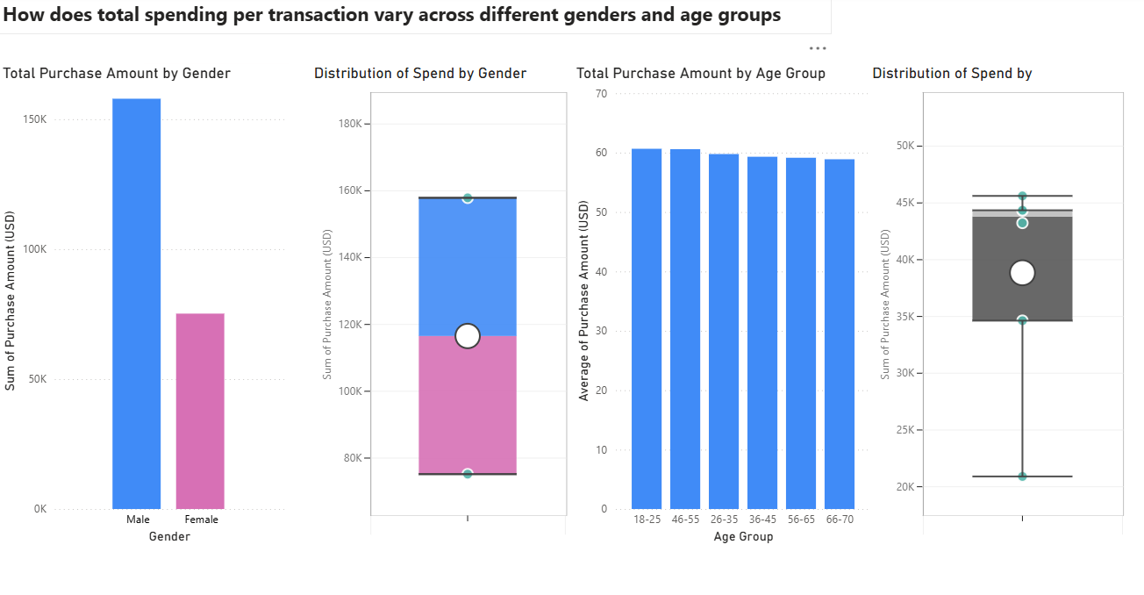
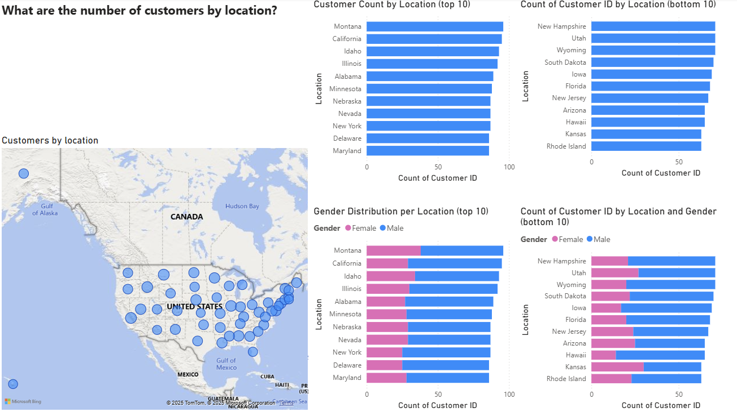
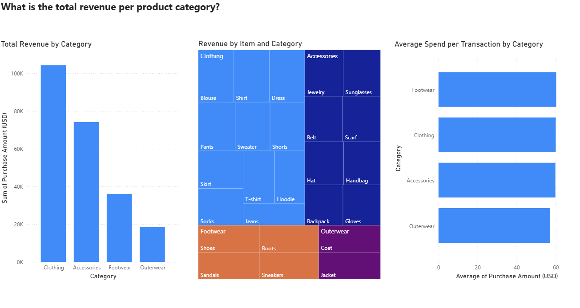
Prototype Walk Through / Demonstration
Han Shen

Slide 14
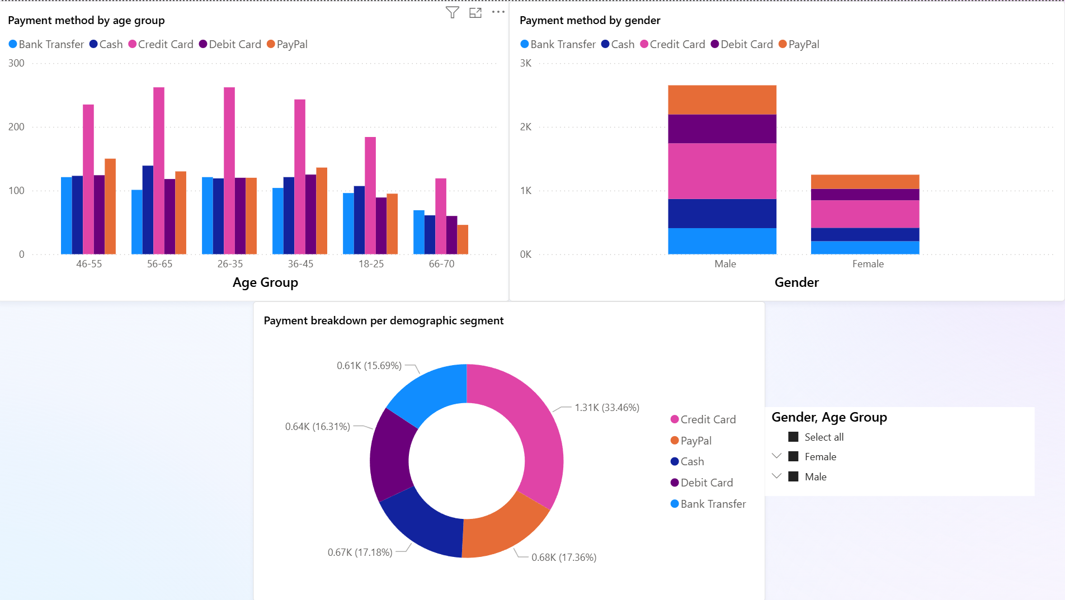
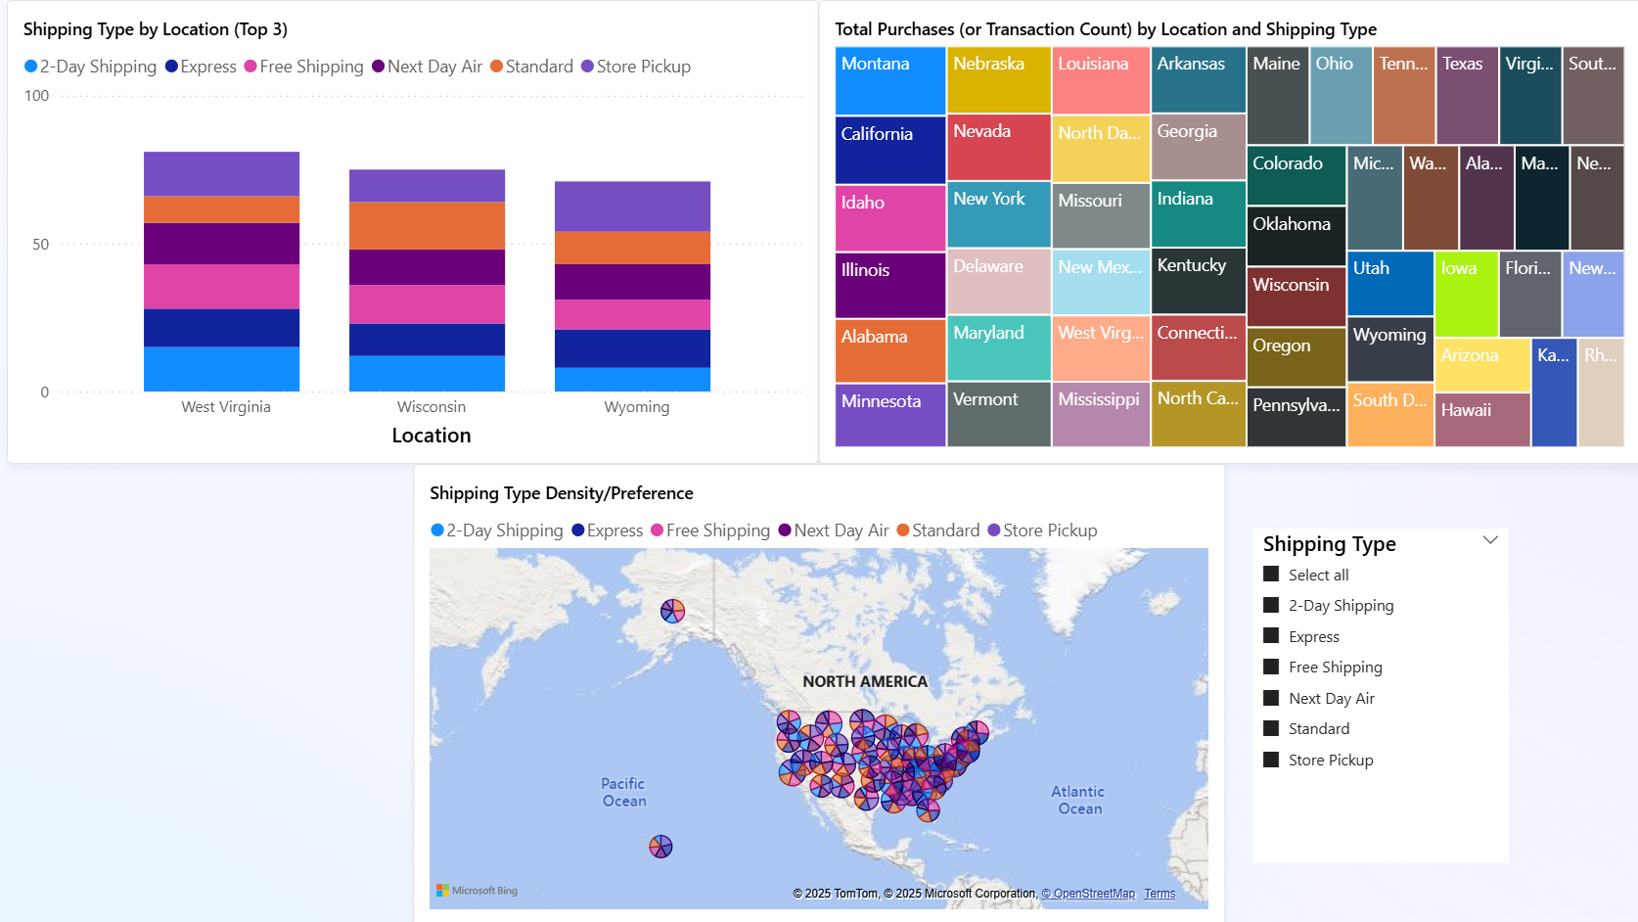
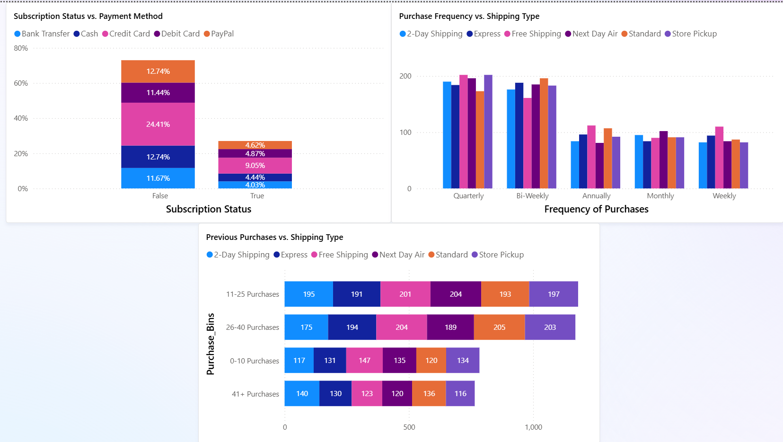
Prototype Walk Through / Demonstration
Eva

Slide 15
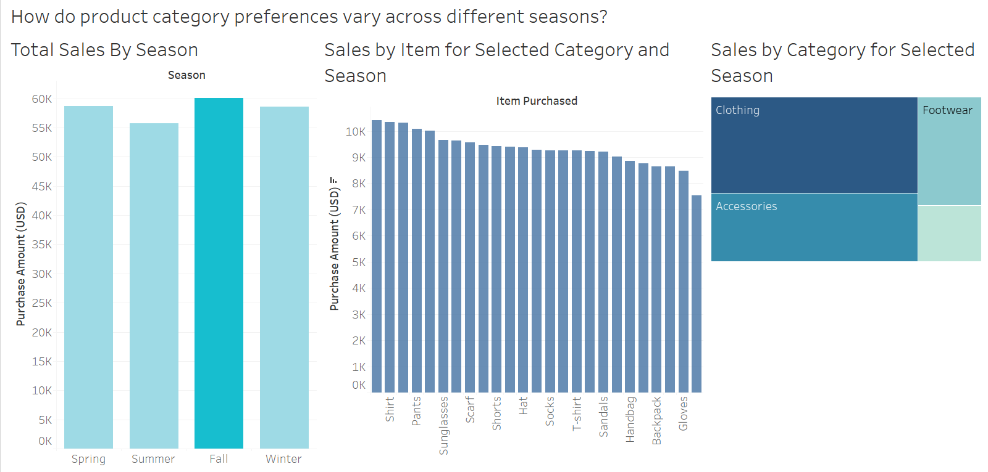
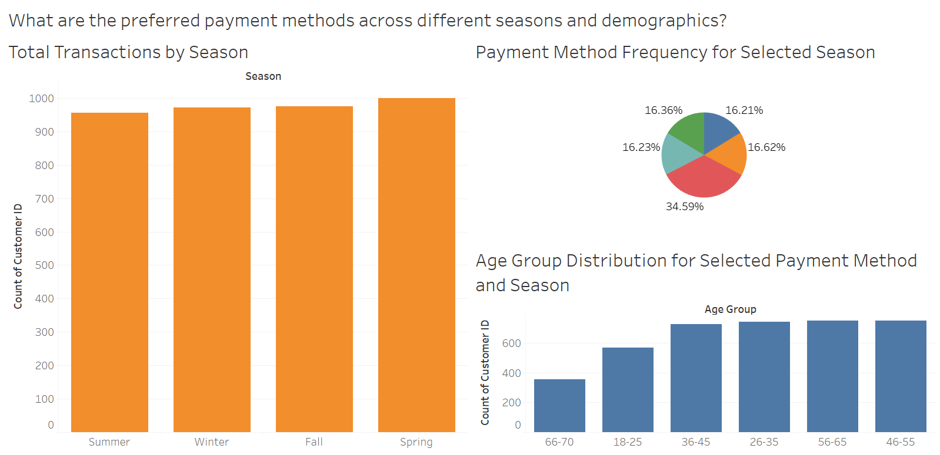
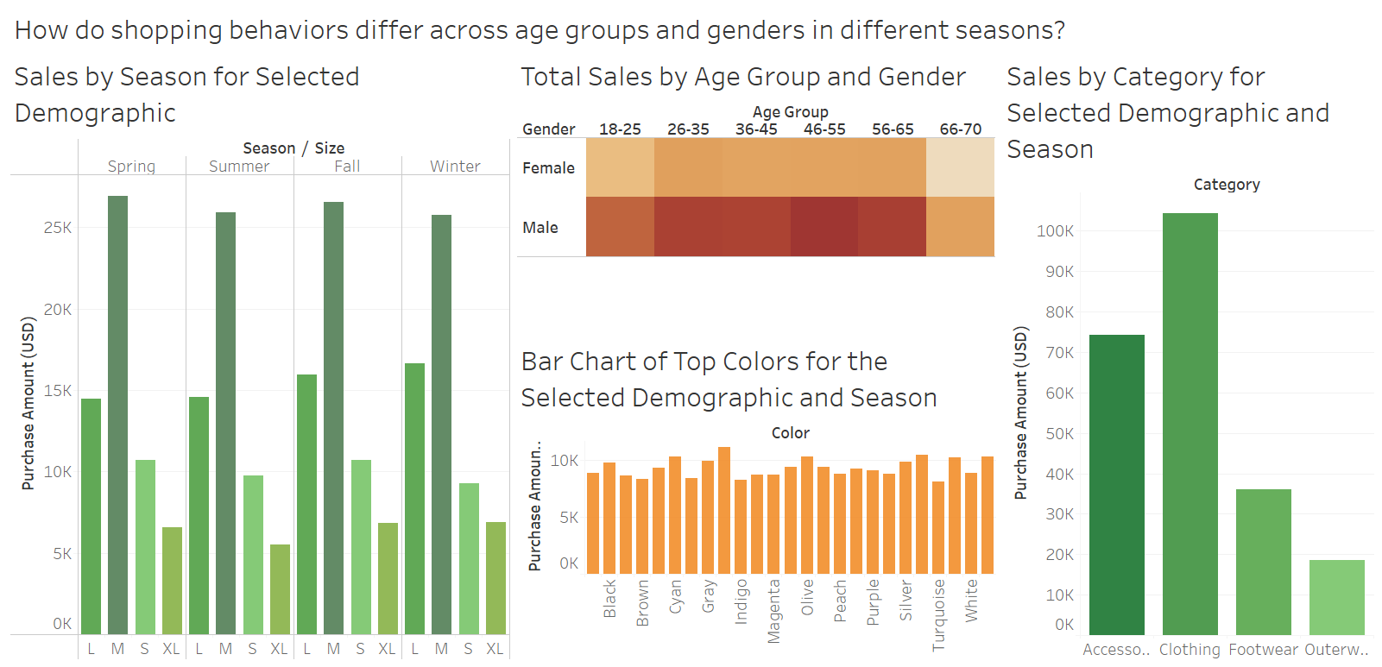
Prototype Walk Through / Demonstration
Muhsinah

